Slide 1
Secure data hiding in images using steganography
CAPSTONE PROJECT
Presented By: ADITYA SINHA
Student Name : ADITYA SINHA
College Name : SHRI SHANKARACHARYA GROUP OF INSTITUTIONS,BHILAI
Department : Computer Science & Engineering

Slide 2
OUTLINE
Problem Statement
Technology used
Wow factor
End users
Result
Conclusion
Git-hub Link
Future scope

Slide 3
Problem Statement
Traditional encryption methods, while effective, make data protection evident, often signaling the presence of sensitive information and increasing the likelihood of interception or unauthorized scrutiny. In contrast, this project leverages image steganography, a technique that embeds secret messages within digital images using Least Significant Bit (LSB) encoding. By subtly modifying pixel values without visibly altering the image, the hidden message remains undetectable to the human eye and standard image analysis tools.
This method provides an added layer of security by allowing information to be transmitted inconspicuously, ensuring that confidential data does not stand out as an obvious target for cyber threats. Unlike traditional encryption, which can raise suspicion, steganography blends the message seamlessly into ordinary media, making it an ideal solution for secure and discreet communication. Whether used for cybersecurity applications, private correspondence, or protecting sensitive corporate data, this approach enhances data security while maintaining a low profile, reducing the risk of detection or interception.

Slide 4
Technology used
Programming Language: Python
Code Editor: Visual Studio Code
Libraries Used: OpenCV (cv2) for image processing, OS
module for file management
Steganography Technique: Least Significant Bit (LSB) encoding for embedding messages
Supported Platform: Windows
Output: PNG image containing securely hidden text

Slide 5
Wow factors
Invisible Encryption: Hides messages within images without altering their visible appearance.
Dual Security: Uses both steganography and password protection for enhanced security.
Lightweight & Fast: Minimal processing time with no need for large encryption keys.
Easy & Accessible: Works on any standard image, making secret communication effortless.
No Suspicion: Unlike traditional encryption, it doesn’t attract attention or look suspicious.

Slide 6
End users
Cybersecurity Experts – Ensuring secure and confidential communication channels.
Journalists & Activists – Safeguarding sensitive information while avoiding surveillance.
Government & Defense Agencies – Facilitating covert operations and secure intelligence exchange.
Businesses & Enterprises – Protecting trade secrets and confidential corporate data.
Everyday Users – Offering a private and reliable method for discreet message sharing.

Slide 7
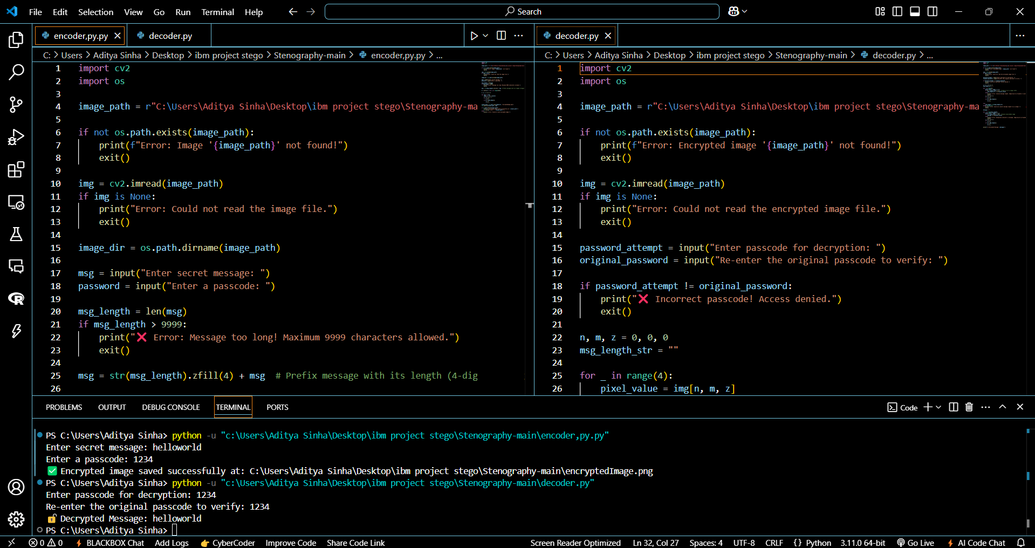
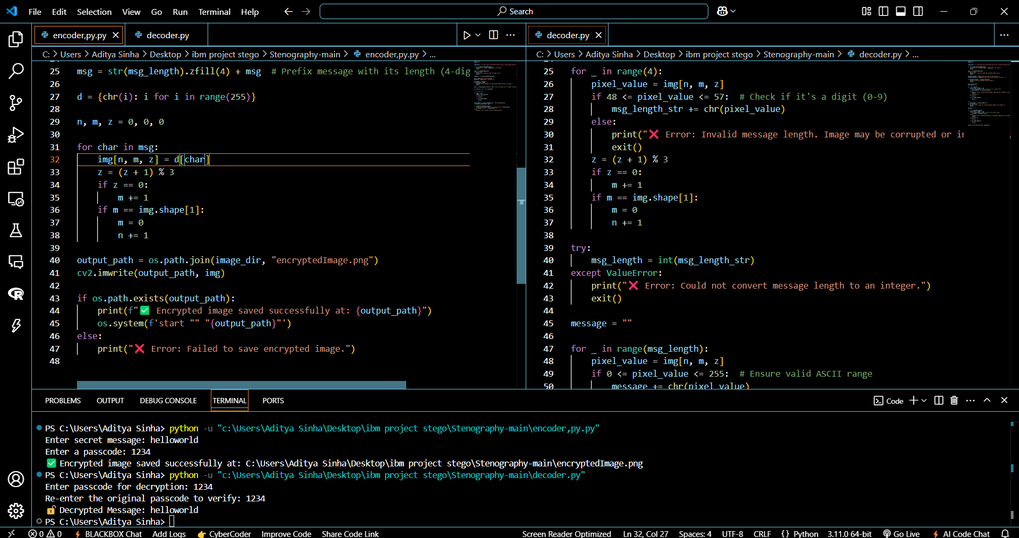
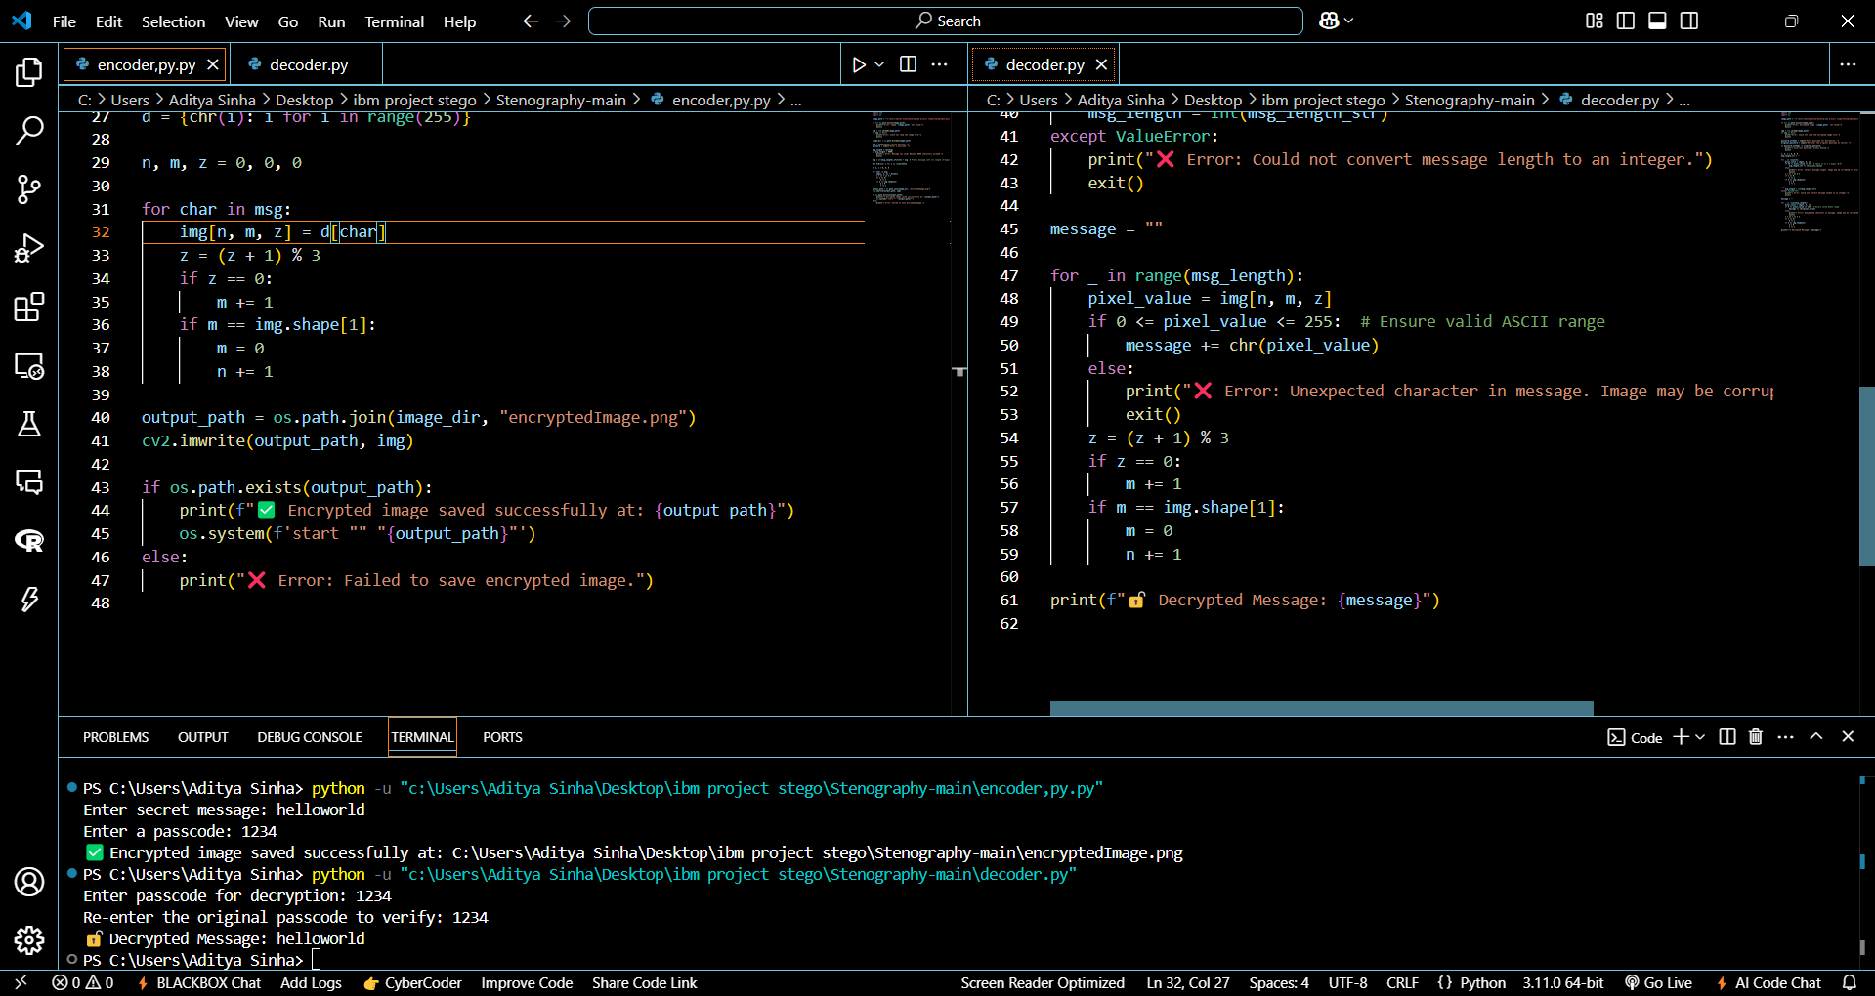
Results

Slide 8
Conclusion
In today's digital landscape, where data security is paramount, this project introduces a sophisticated yet subtle method for secure communication. Utilizing image steganography with Least Significant Bit (LSB) encoding, it seamlessly embeds messages within images while preserving their original appearance. Unlike conventional encryption techniques, this approach keeps sensitive information concealed in plain sight, minimizing the likelihood of detection or interception.
Moreover, the integration of password protection adds an extra layer of security, ensuring that only authorized individuals can access the hidden message. This technique is invaluable for cybersecurity professionals, journalists, businesses, and anyone seeking a reliable, discreet, and highly effective means of transmitting confidential information.

Slide 9
GitHub Link
https://github.com/adityasunnysinha/Steganography

Slide 10
Future scope(optional)
Advanced Security: Combine robust encryption methods with steganography for heightened protection.
Versatile File Support: Enable message embedding in audio, video, and document formats.
AI-Powered Stealth: Utilize artificial intelligence to enhance message concealment and evade detection.
Seamless Accessibility: Develop a cloud-based or mobile application for secure and convenient usage.
Optimized Storage: Improve algorithms to accommodate larger messages while maintaining image integrity.

Slide 11
THANK YOU

